Slide 1
Virginia City Highlands Groundwater Investigation Update Year 1 Progress Report
By David W. Smith (dwsmith@usgs.gov) and Kip K. Allander (kalland@usgs.gov)
VC Highlands Fire Station
May 10th, 2018

Slide 2
Outline
Review – Why are we monitoring groundwater resources
Previously measured water-level declines
Deepening and re-drilling of domestic wells
Current groundwater well network
How to access data
Site data based on parcel size (1/10/40 acres)
Virginia City Highlands Data
Precipitation data
Water-level conditions (increases and declines)
Continuous water-level data
Lousetown Creek streamflow data

Slide 3
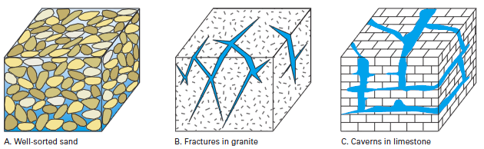
Is my well completed in an Aquifer?
Aquifer – a body of permeable rock that can transmit water
Water occupies spaces between sand, silt, and gravel in fill; or fractures and cavities in rocks.
Water movement through and storage within the subsurface is governed by aquifer properties.
Permeability is ability of water to move through material.
Storage is amount of water stored in a given volume of aquifer.

Slide 4
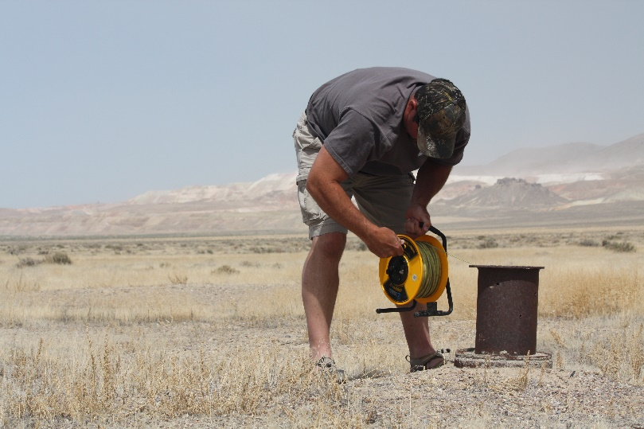
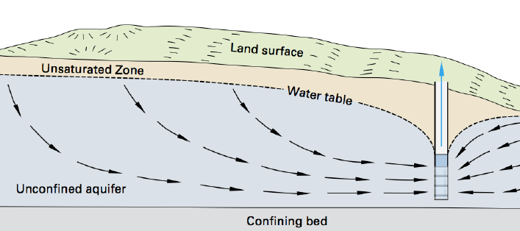
Change in groundwater levels are observed with water-level measurements

Slide 5
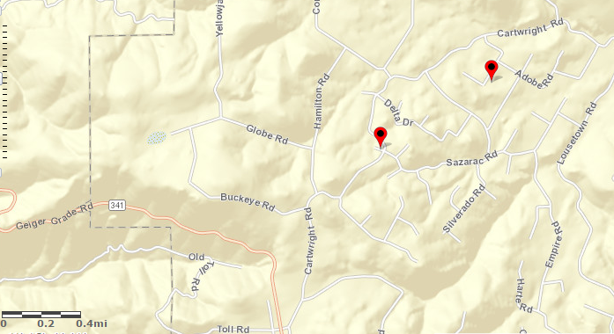
USGS Monitoring Wells in VC Highlands
32ABCD1
32CBBD1

Slide 6
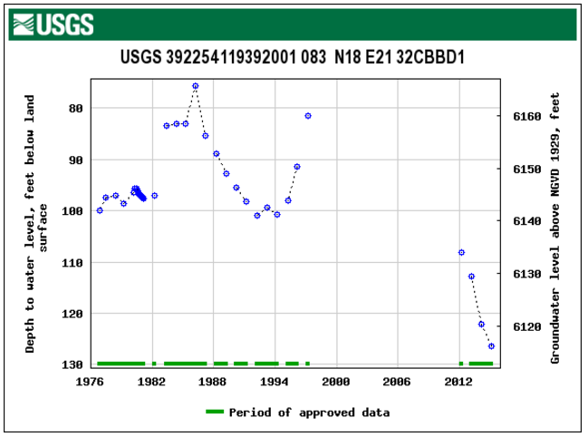
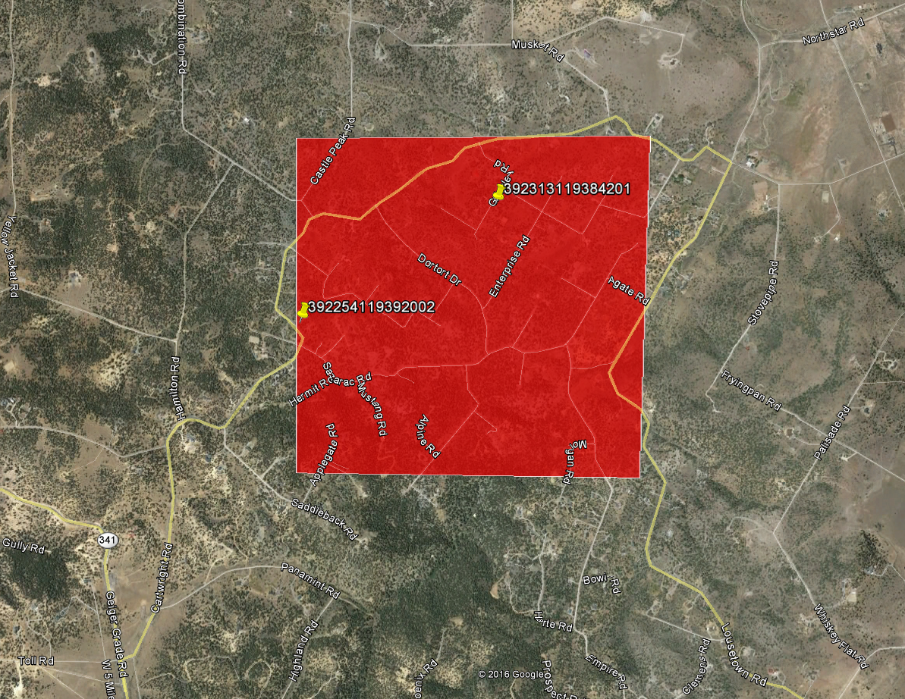
USGS Annual Well Locations
1997 to 2016
Decline of 50’
Well Re-drilled in 2015
Notes:
Water levels can recover by 10's of feet during most extreme wet years like 1983, 1995, and 1997.
However, recharge events are too infrequent too balance the observed declines.

Slide 7
USGS Monitoring Wells in VC Highlands
32ABCD1
32CBBD1

Slide 8
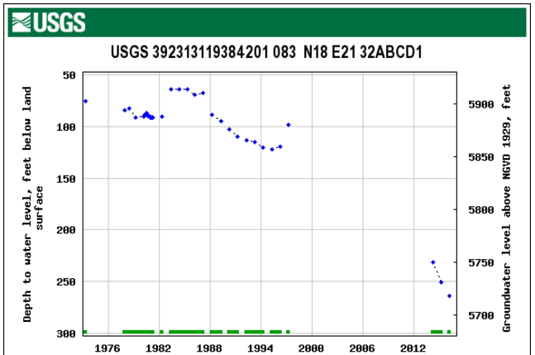
USGS Annual Well Locations
1997 to 2016
Decline of 165’
Are wells being re-drilled in areas of water-level decline?

Slide 9
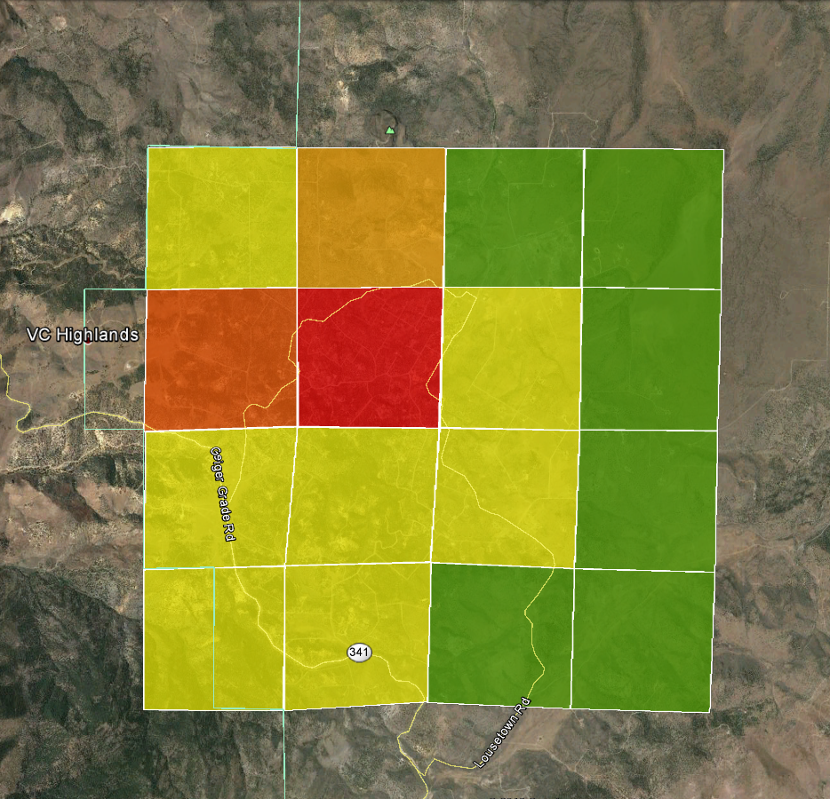
34 Wells
4 Replaced
12%
25 Wells
4 Replaced
16%
25 Wells
0 Replaced
0%
7 Wells
0 Replaced
0%
53 Wells
12 Replaced
23%
194 Wells
50 Replaced
28%
37 Wells
5 Replaced
14%
9 Wells
0 Replaced
0%
34 Wells
4 Replaced
12%
79 Wells
9 Replaced
11%
57 Wells
4 Replaced
7%
7 Wells
0 Replaced
0%
2 USGS monitoring wells shown earlier are in this Section
15 Wells
2 Replaced
12%
42 Wells
3 Replaced
7%
3 Wells
0 Replaced
0%
2 Wells
0 Replaced
0%

Slide 10
Project Status – Year 1 Objectives
Project timeline 15 percent complete (July-May)
Monitoring and study timeline July, 2017 to June, 2022
First year objectives field work and data collection
Year 1 Tasks
Establish Groundwater Monitoring Network
Install continuous pressure transducers
Install 4 precipitation gages
Measure flow of Lousetown Creek (Runoff from the VC Highlands)
Flow loss measurements in Lousetown Creek (Recharge potential)
Collect Survey-Grade GPS at well measuring points
Collect cuttings samples from domestic well drill

Slide 11
Status Update –Groundwater Well Network
Visited 62 domestic wells
4 wells had physical obstructions in the well preventing measurement
3 wells were close to other wells already added to the network.
Limited to area of volunteers, good spatial distribution
55 wells in the VC Highlands network
1 acre parcels – 40 wells (includes 20 parcels between 2 and 4 acres)
10 acre parcels – 14 wells
40 acre parcel – 1 well (limited by volunteers)

Slide 12
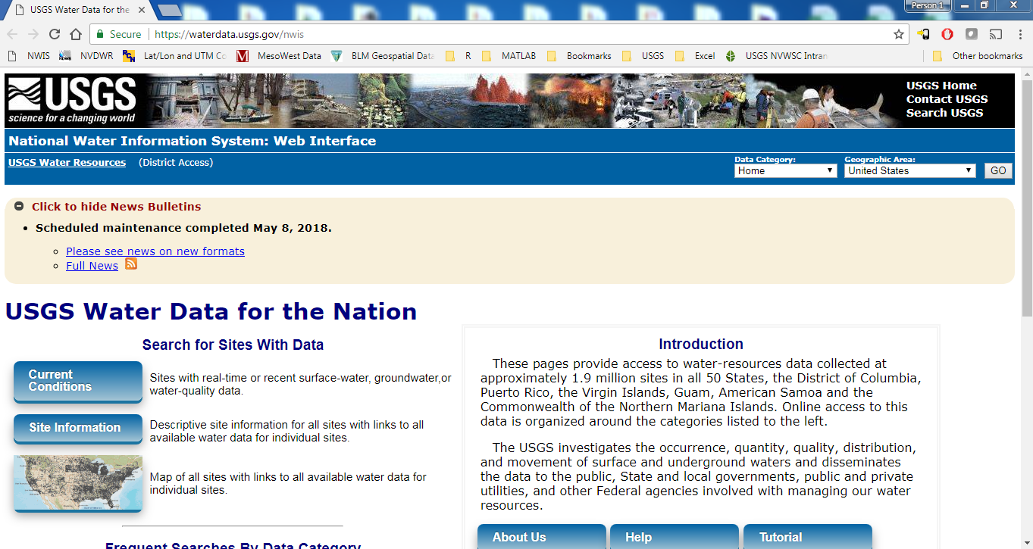
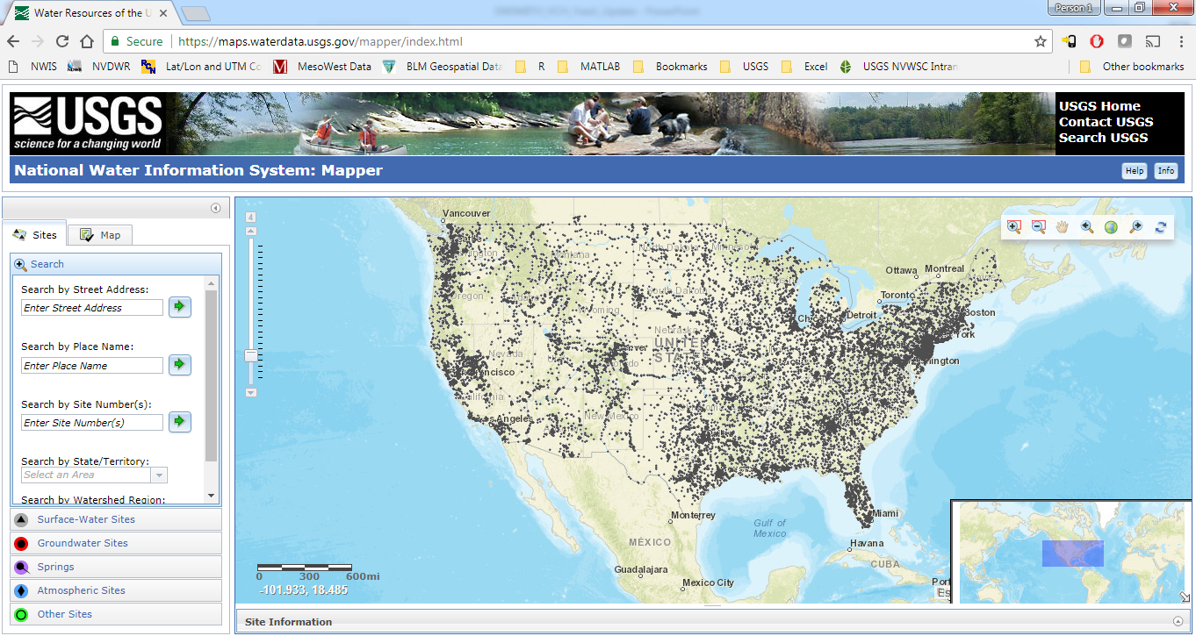
How to access groundwater data online
https://waterdata.usgs.gov/nwis

Slide 13
How to access groundwater data online

Slide 14
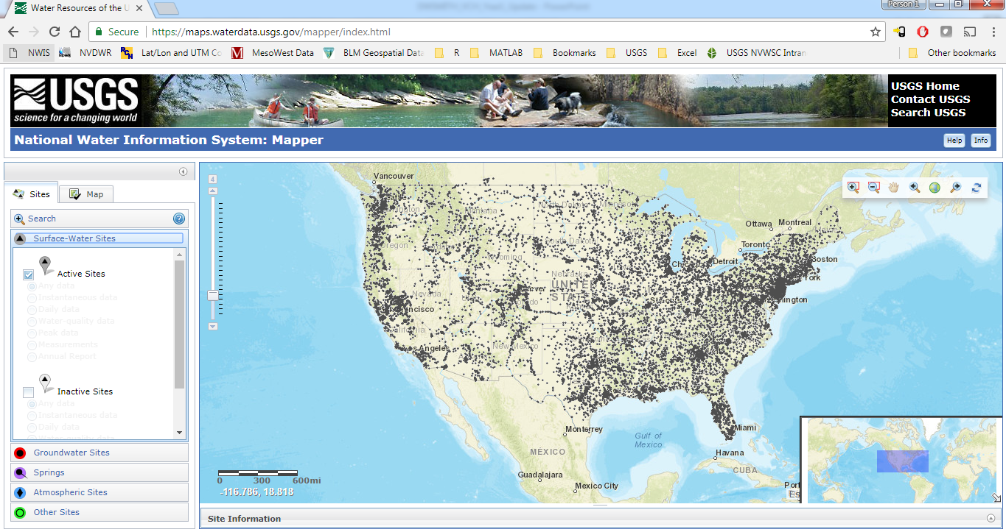
Surface water sites (grey) automatically displayed

Slide 15
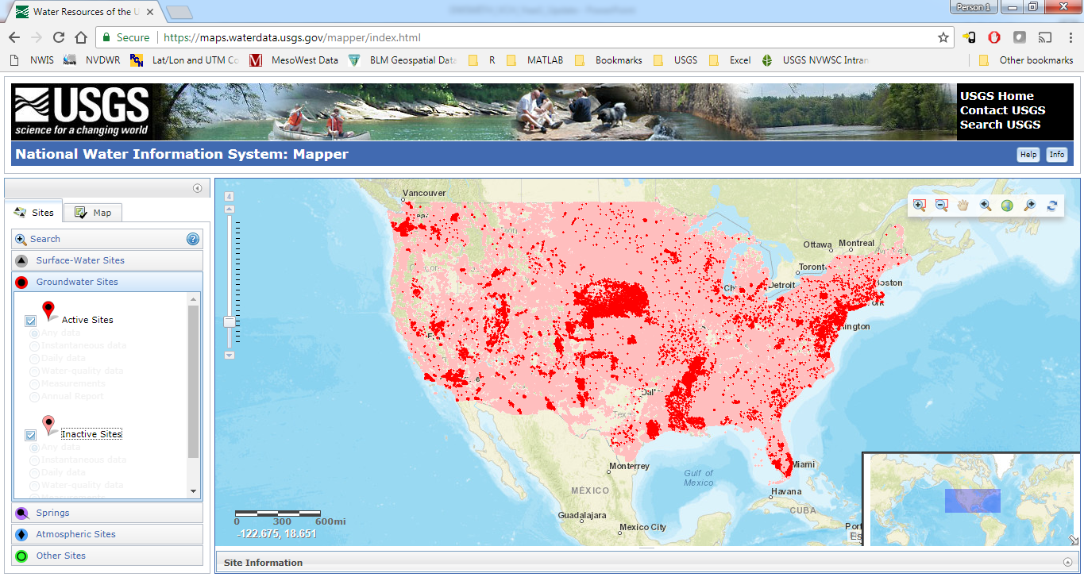
Active (red) & Inactive (pink) site locations
Scroll or use zoom bar
to find VC Highlands Sites

Slide 16
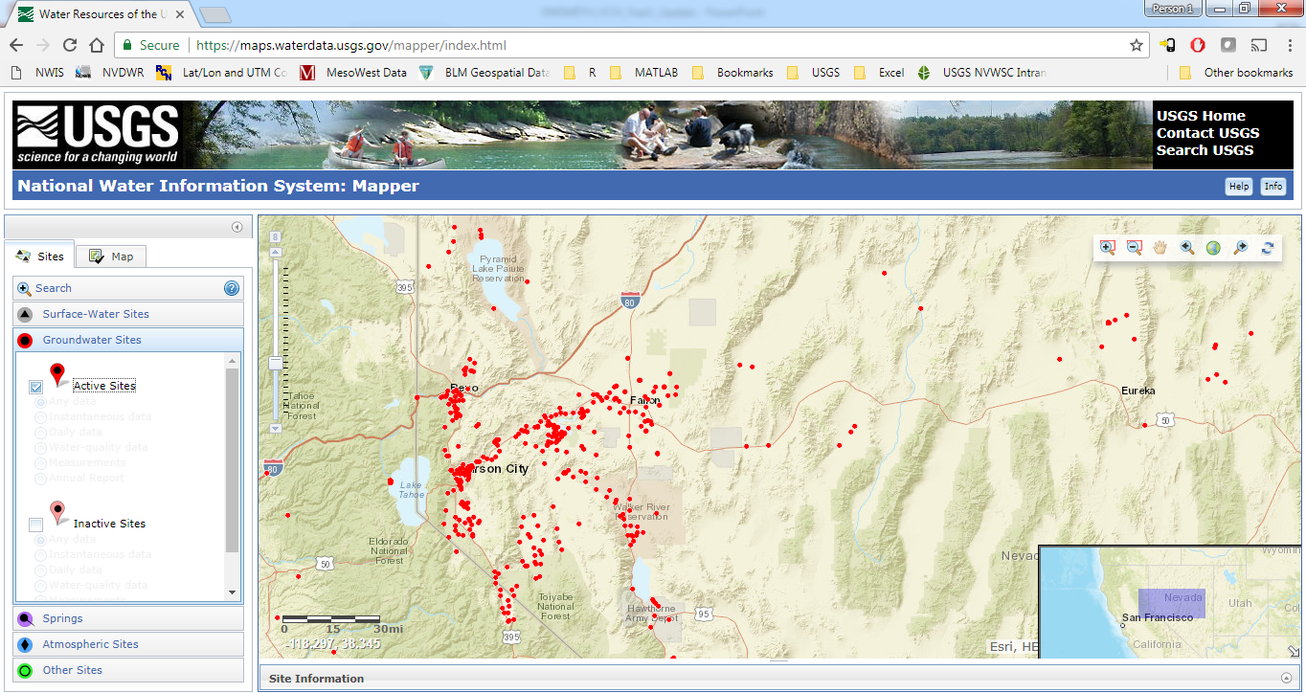
Zoom to Northwestern Nevada
Zoom (scroll) to find VC Highlands Sites

Slide 17
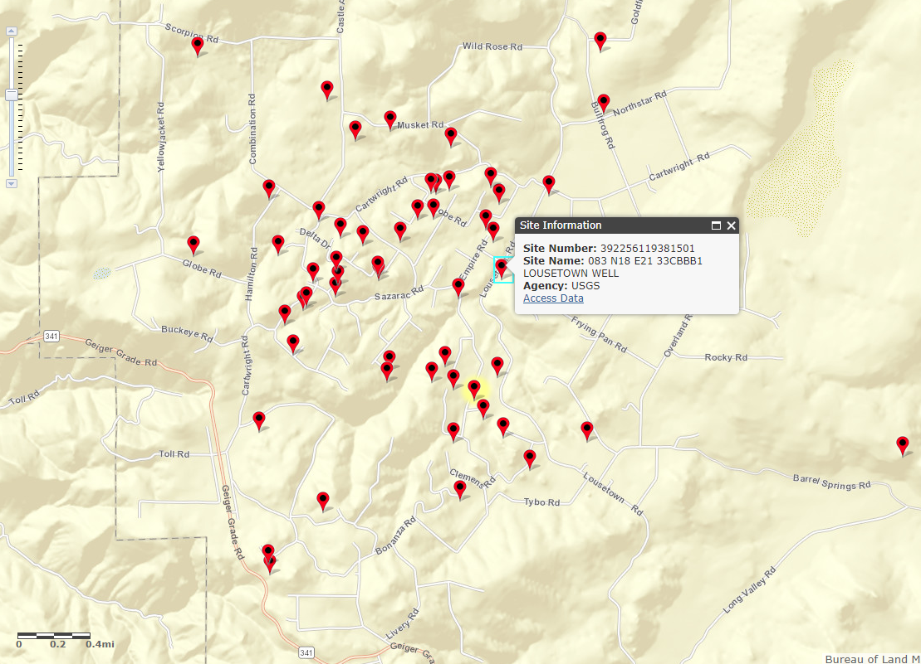
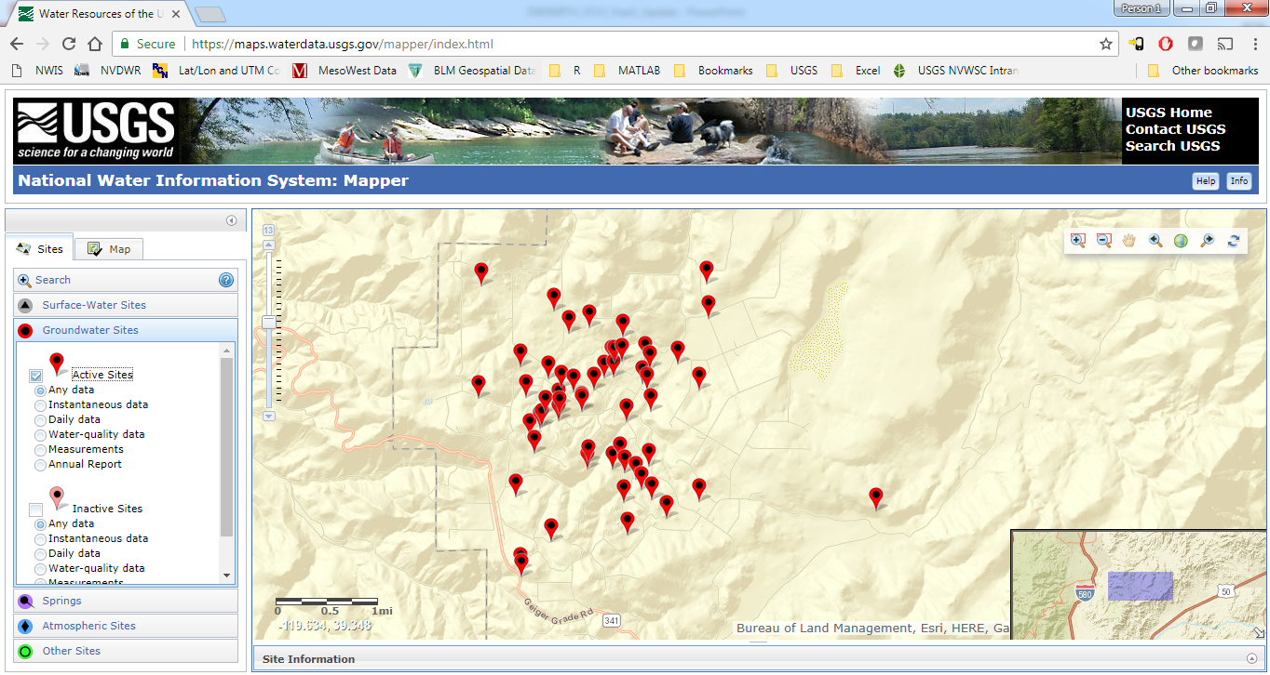
VC Highlands Groundwater Network (55 Wells)
Please send an email for a link to sites [dwsmith@usgs.gov]

Slide 18
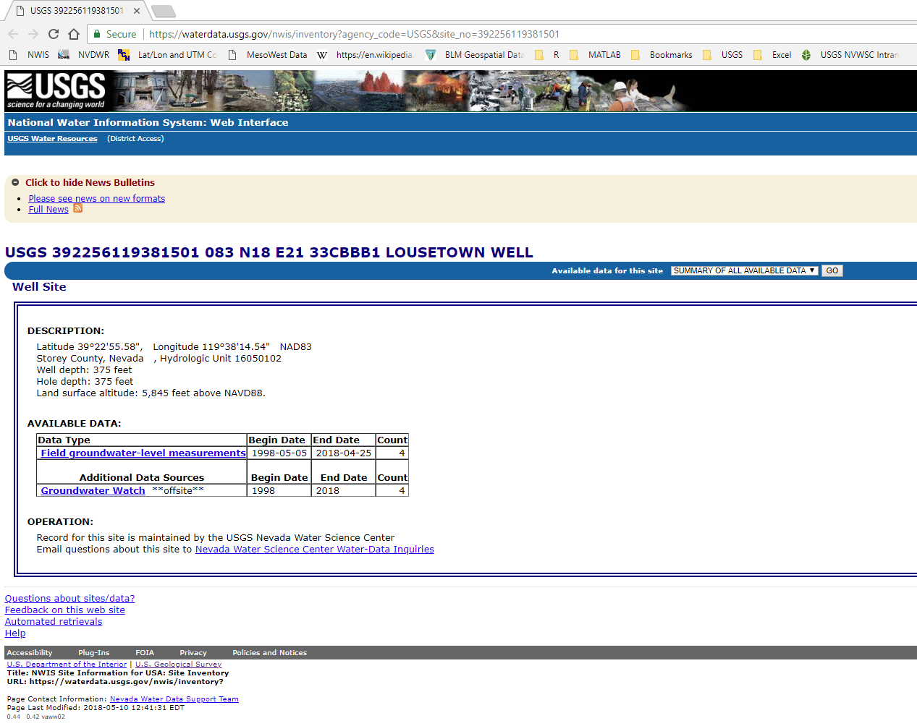

Slide 19
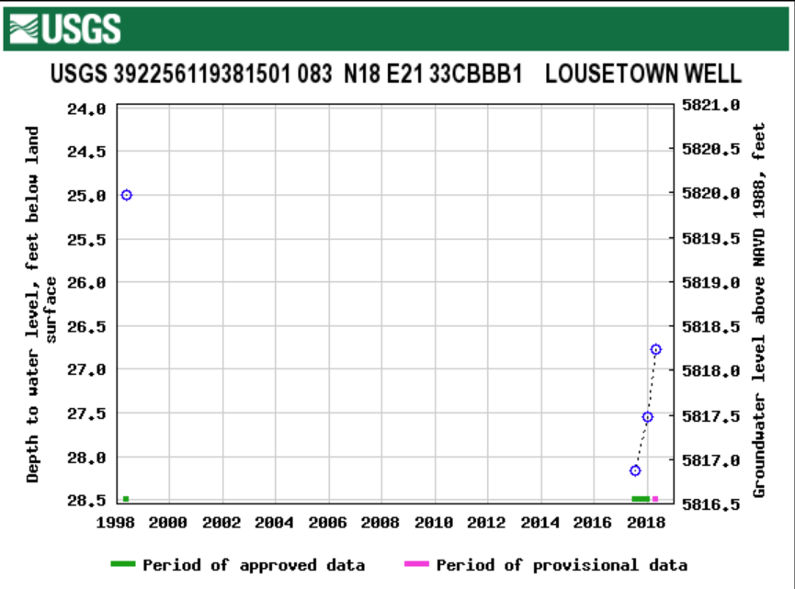
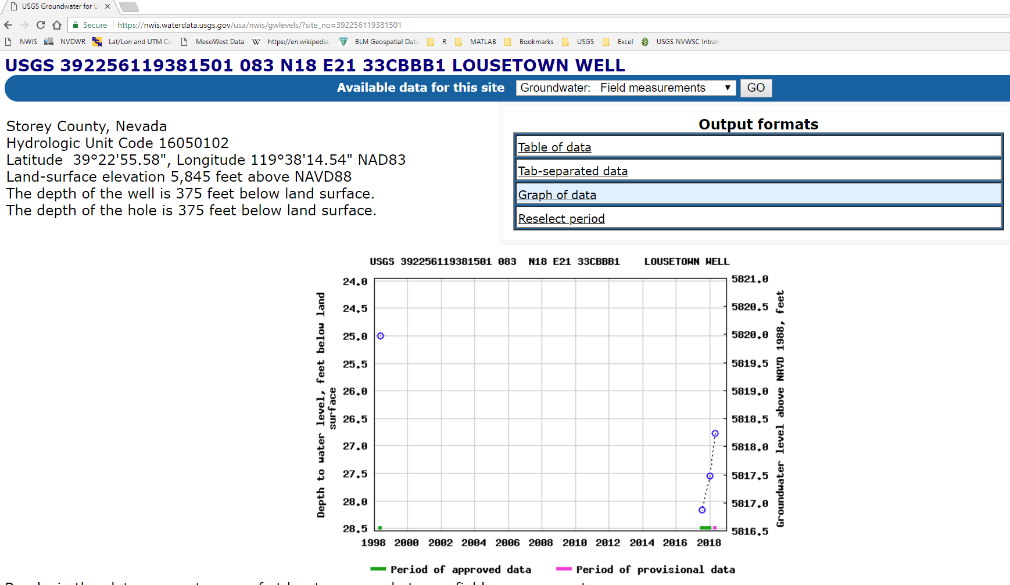
Graph of Water-level Data
Driller’s Report water level
USGS quarterly water-level
measurements
Water-level rise ~1.4 feet

Slide 20
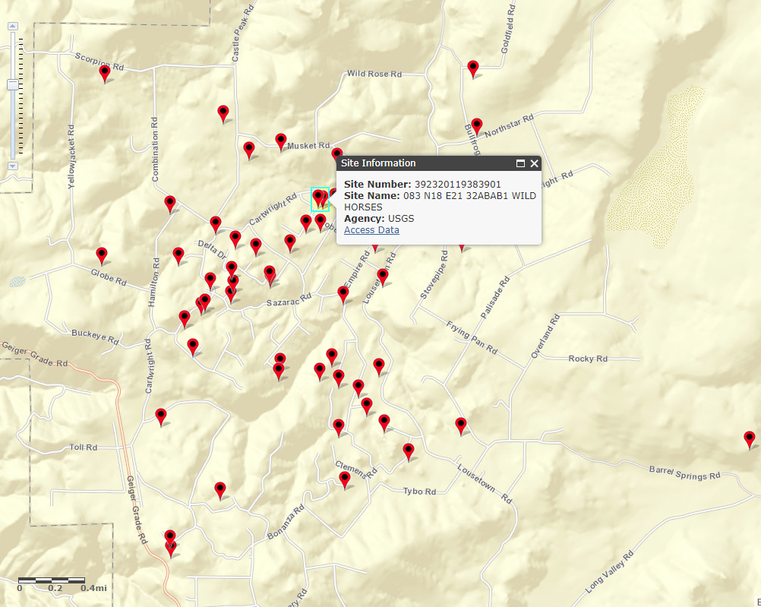
Groundwater Sites continued

Slide 21
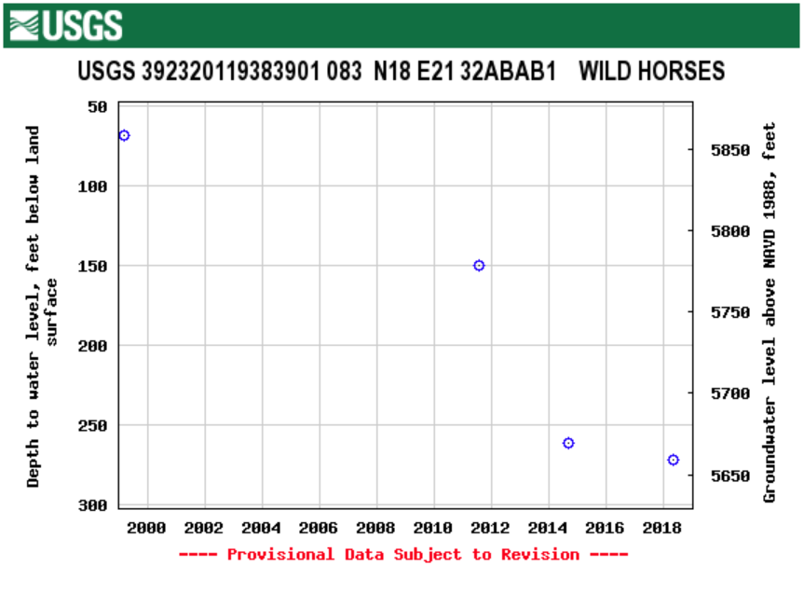
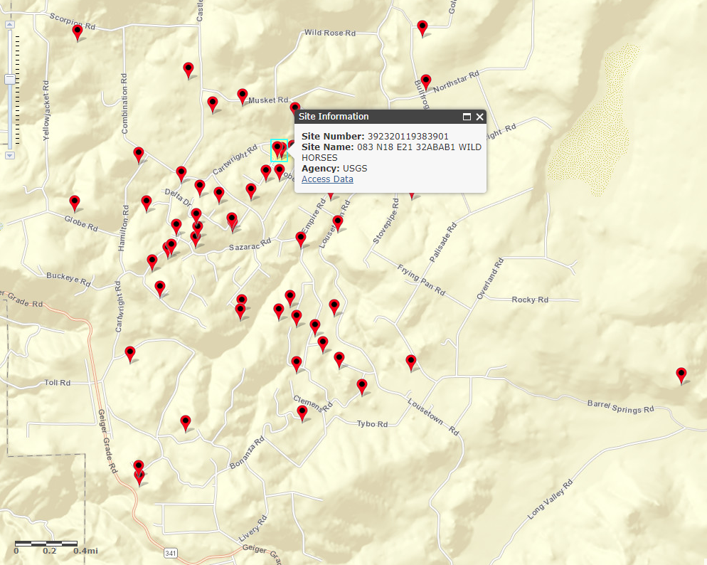
204 ft decline from 1999-2018
-6.6 ft/year
-2.7 ft/year
-36.0 ft/year
Total well depth 472’

Slide 22
USGS Monitoring Wells in VC Highlands
32ABCD1
32CBBD1

Slide 23
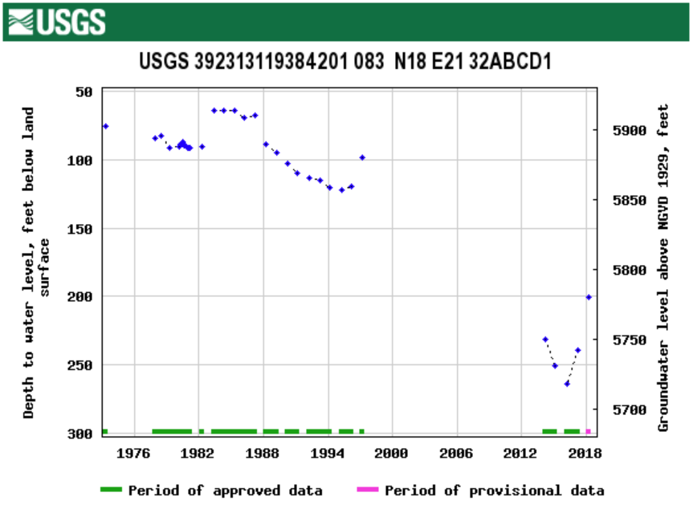
USGS Annual Well Locations
1997 to 2016
Decline of 50’
Increase of 63.9 feet
from 2016-2018
Well Re-drilled in 2015
Notes:
Water levels can recover by 10's of feet during most extreme wet years like 1983, 1995, and 1997.
However, recharge events are too infrequent too balance the observed declines.

Slide 24
USGS Monitoring Wells in VC Highlands
32ABCD1
32CBBD1

Slide 25
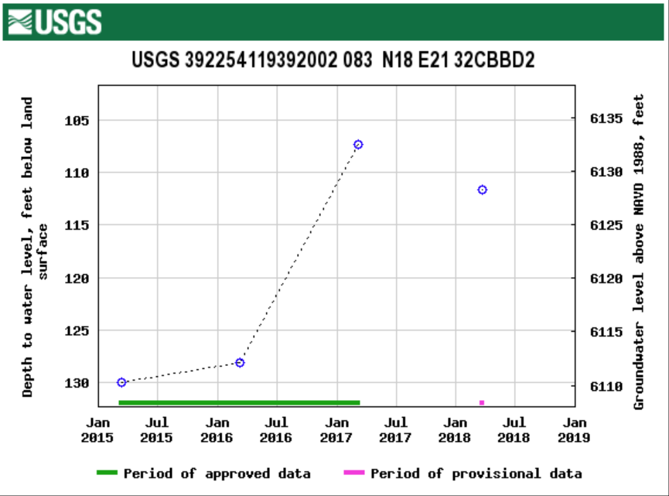
USGS Annual Well Locations
Well Re-drilled in 2015 had previous decline of 50 ft
Increase of 20.8 ft
from 2016-17
Decline of 4.3 ft
from 2017-18
Notes:
Water levels can recover by 10's of feet during most extreme wet years like 1983, 1995, and 1997.
However, recharge events are too infrequent too balance the observed declines.

Slide 26
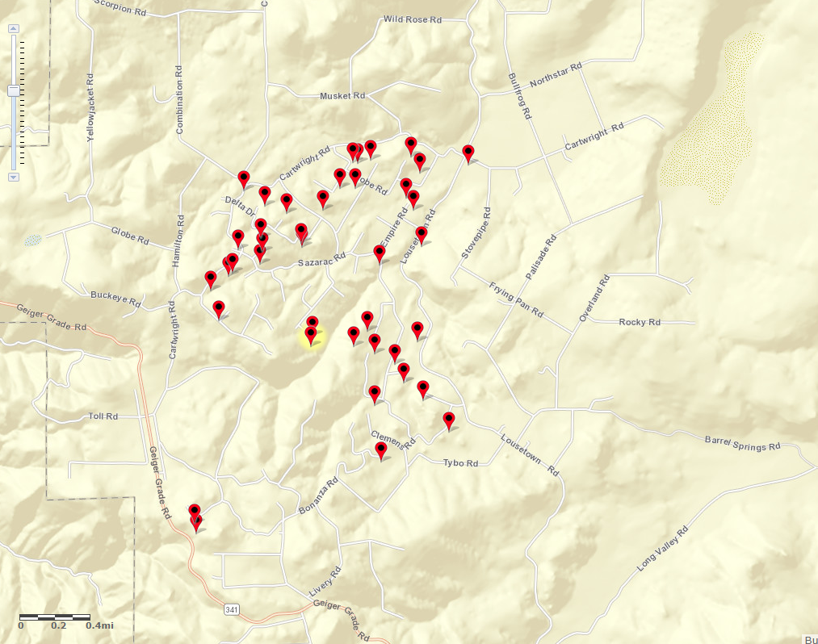
1 Acre Groundwater Sites (40 sites)
Please email for a link to sites [dwsmith@usgs.gov]

Slide 27
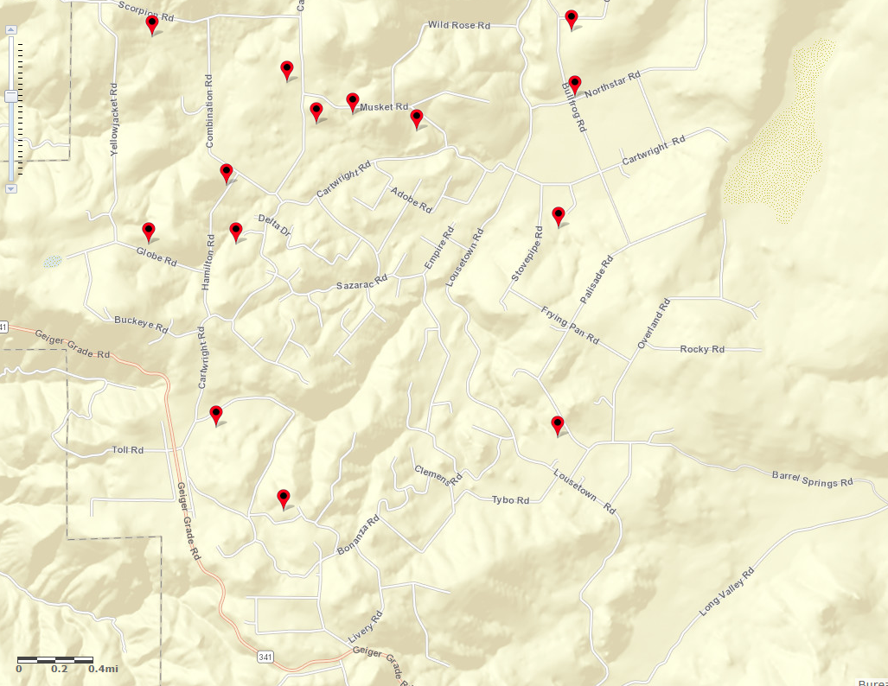
10 Acre Groundwater Sites (14 sites)
Please email for a link to sites [dwsmith@usgs.gov]

Slide 28
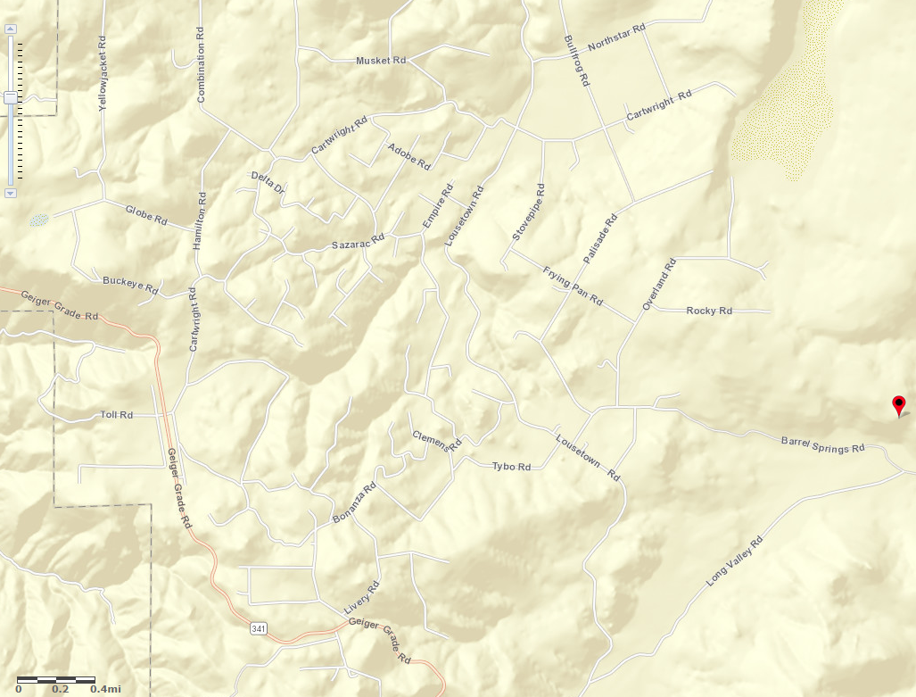
40 Acre Groundwater Sites (1 site)
Please email for a link to sites [dwsmith@usgs.gov]

Slide 29
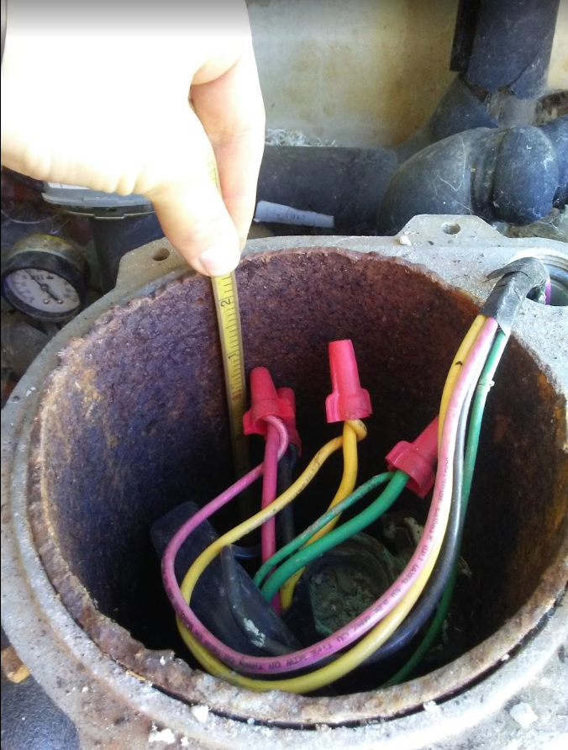
Groundwater Data - what we’re seeing so far (3 out of 4 quarterly measurements)
Parcel Size | Average Parcel Size (acres) | Average Well Depth | water-level change over winter 17/18 (feet) | Greatest decline (feet) | Greatest increase (feet)
1 | 1.8 | 277 | -0.6** | -10.4 | 39.4**
10 | 10.4 | 373 | -0.4 | -2.1 | 5.4
40 | 40.0 | 918* | -0.04 | - | -
 | *Only one site, not an average **Two wells in area where significant drainage by wells outliers removed from average calculation
47 percent of wells in the network have shown an increase during the 17/18 winter.

Slide 30
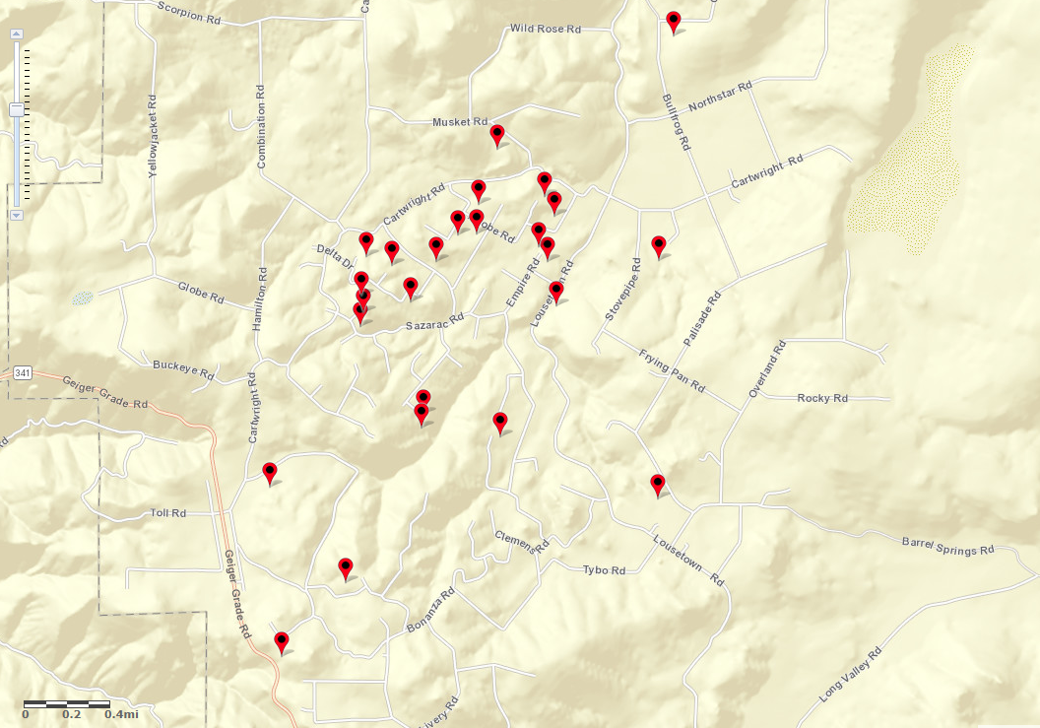
Preliminary Data – sites with increasing water-level trend through winter 17/18

Slide 31
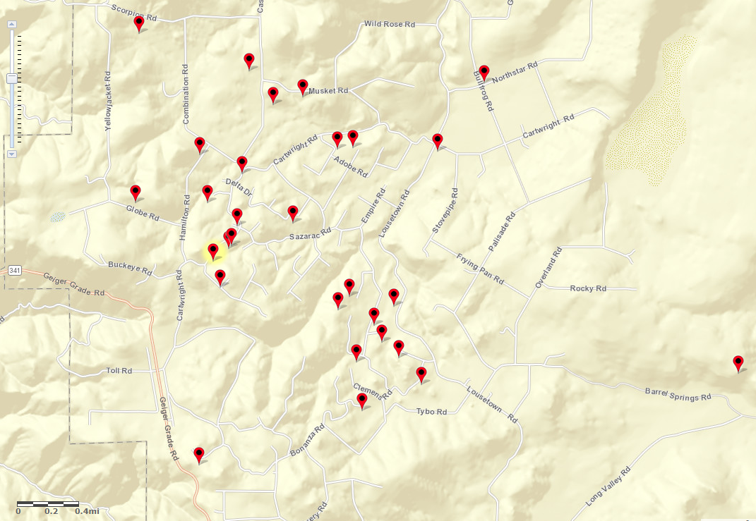
Preliminary Data – sites with decreasing water-level trend through winter 17/18

Slide 32
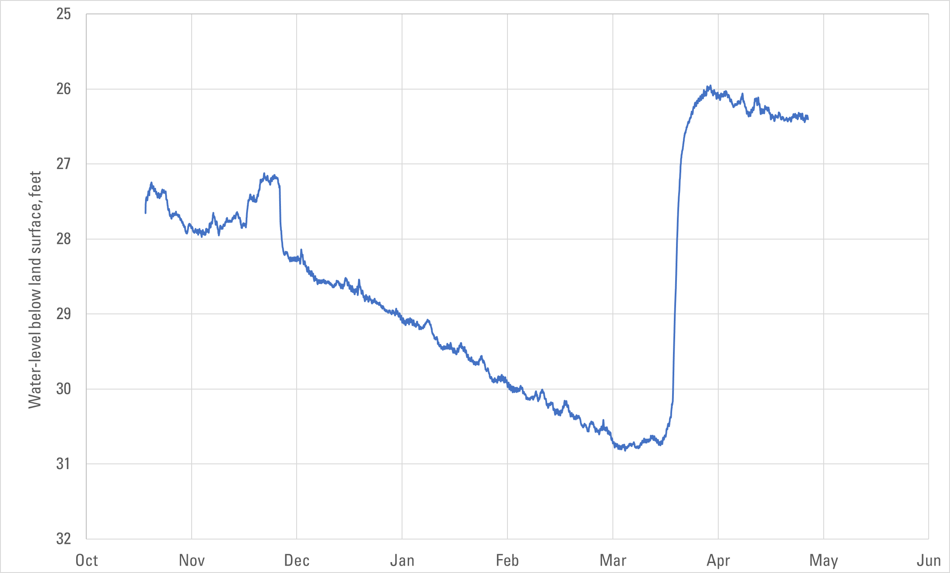
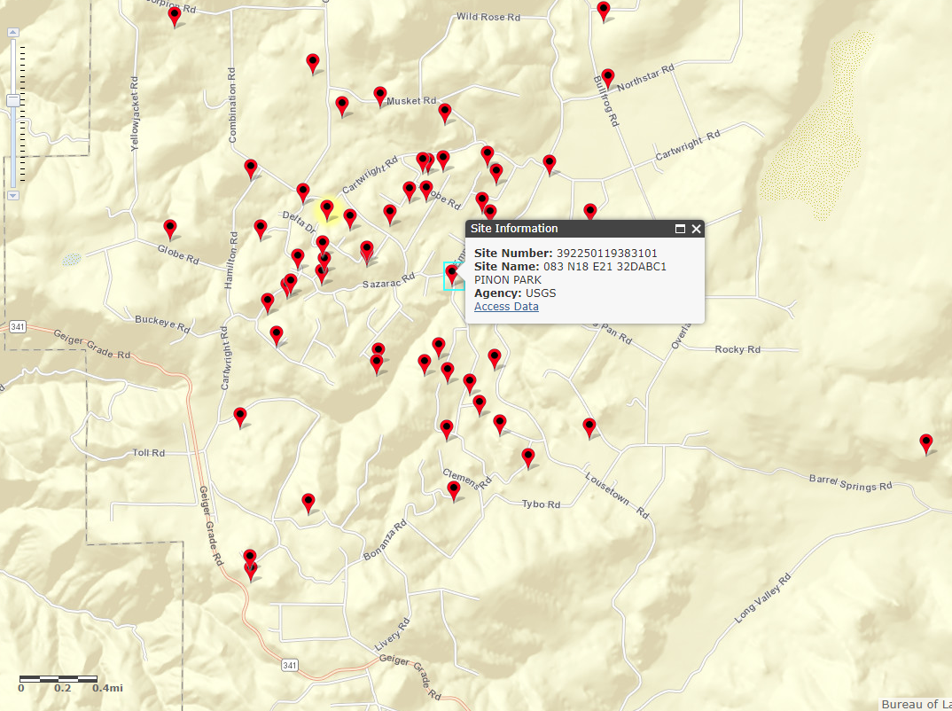
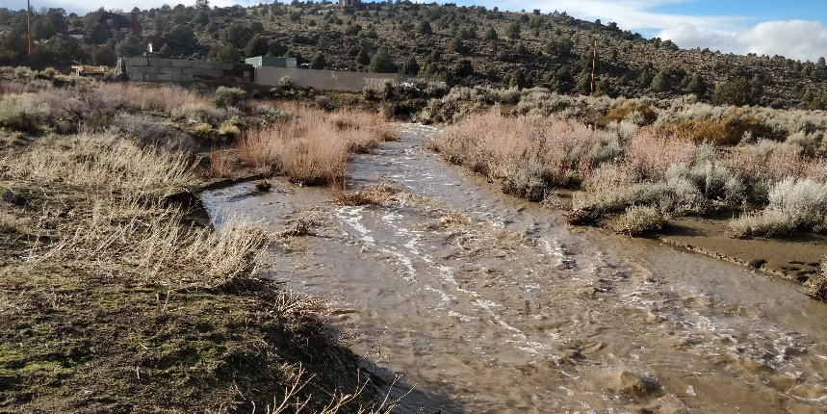
Continuous Groundwater Data - Pinion Park Recharge Event Example 3/22/2018
Rain on Snow Flow
Event March 22nd

Slide 33
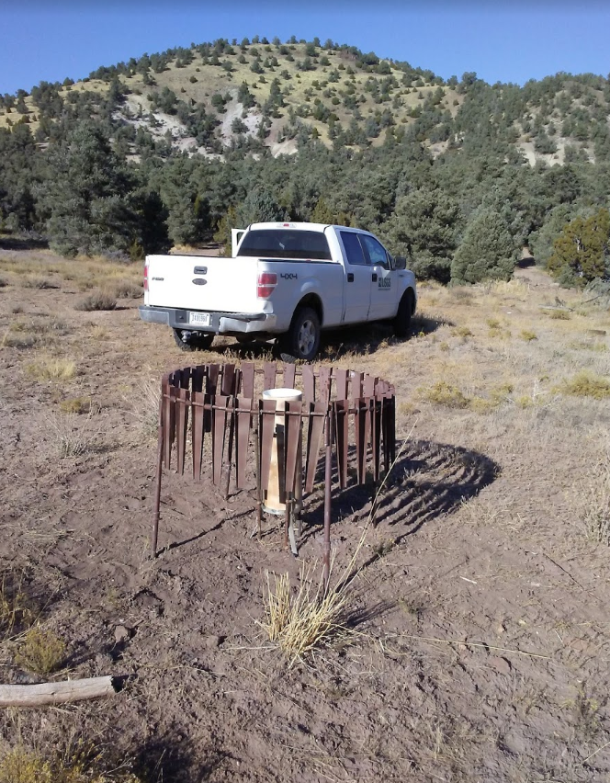
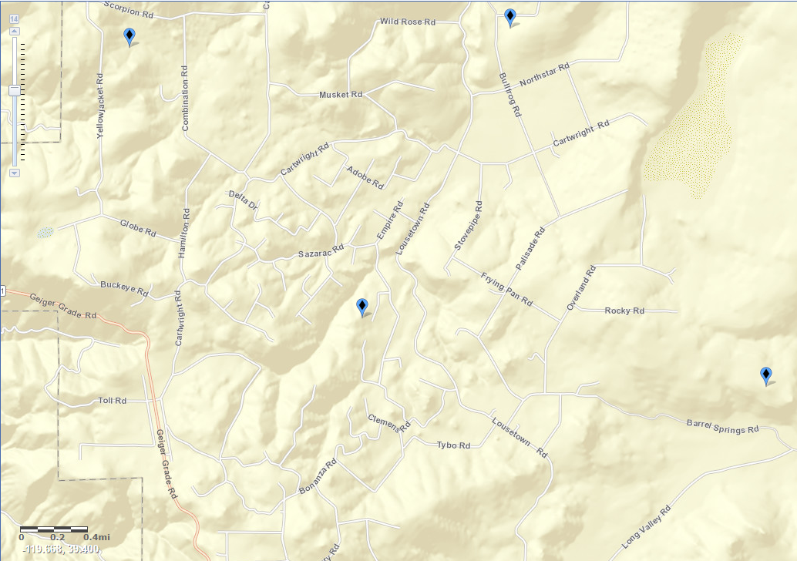
Installed 4 Precipitation Sites at varying altitudes in the VC Highlands (annual precip.)

Slide 34
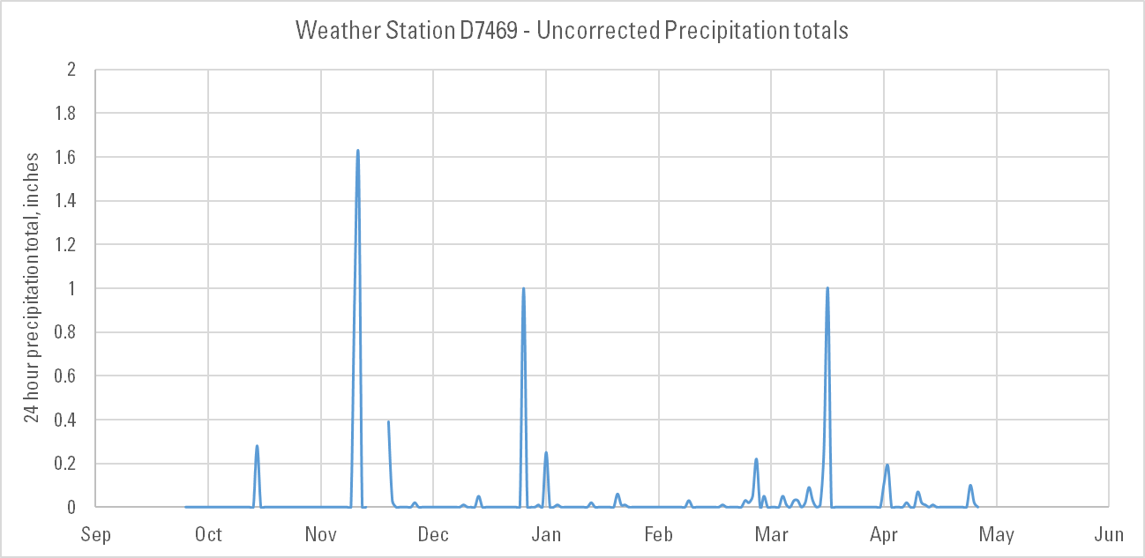
Rain Events Station D7469 VC Highlands
The Citizen Weather Observation Program (CWOP) Stations
Average Precipitation of 8.46 inches from Bulk Precip. Gages
Estimate of ~6,500 acre-ft/year

Slide 35
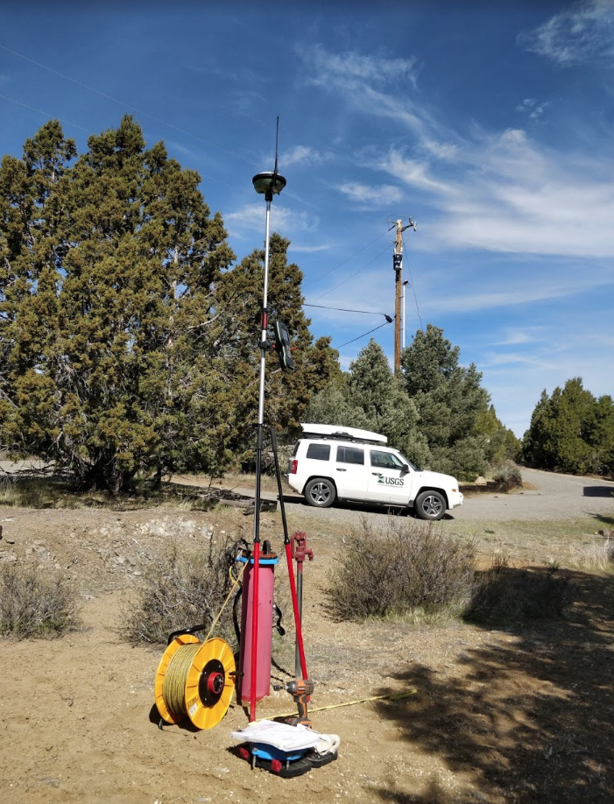
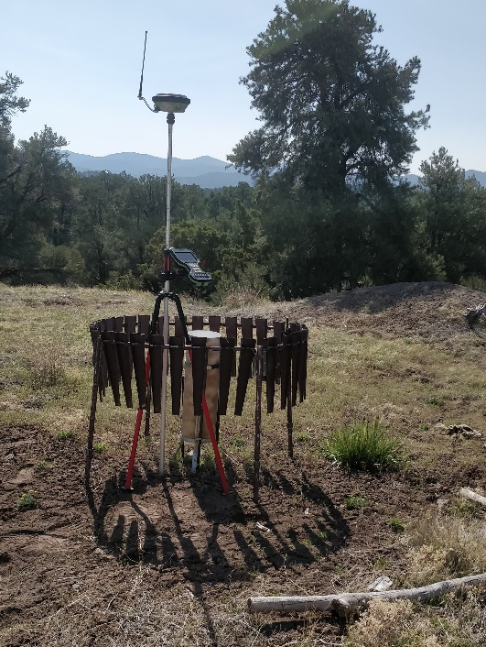
Survey Grade Elevation Data Collected
Differential GPS collected with 3rd quarterly measurements.
Accuracy ~5 cm or 2 inches above sea level
Data will be used to make a water-level table and change map.

Slide 36

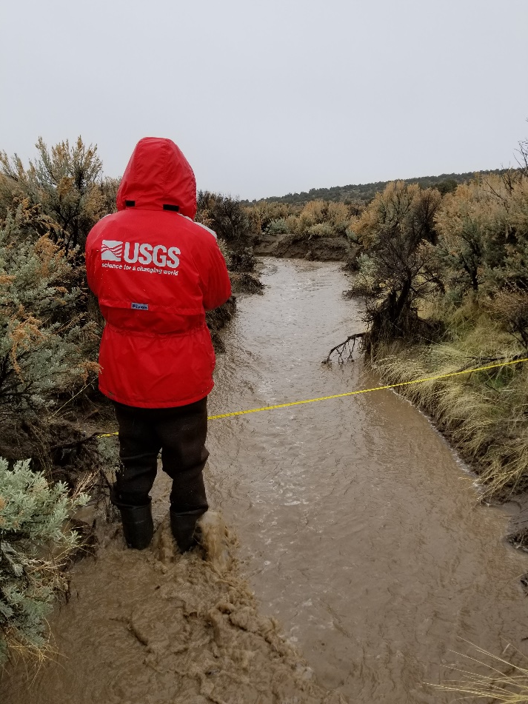
Flow Measurements of Lousetown Creek
Collected 7 flow measurements on Lousetown Creek
Peak measurement - 75.1 cfs on 3/22/2018
Data will be used to estimate annual runoff

Slide 37
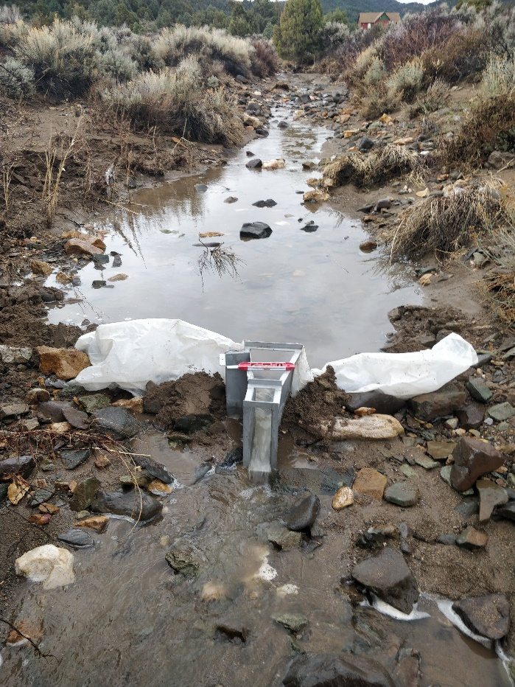
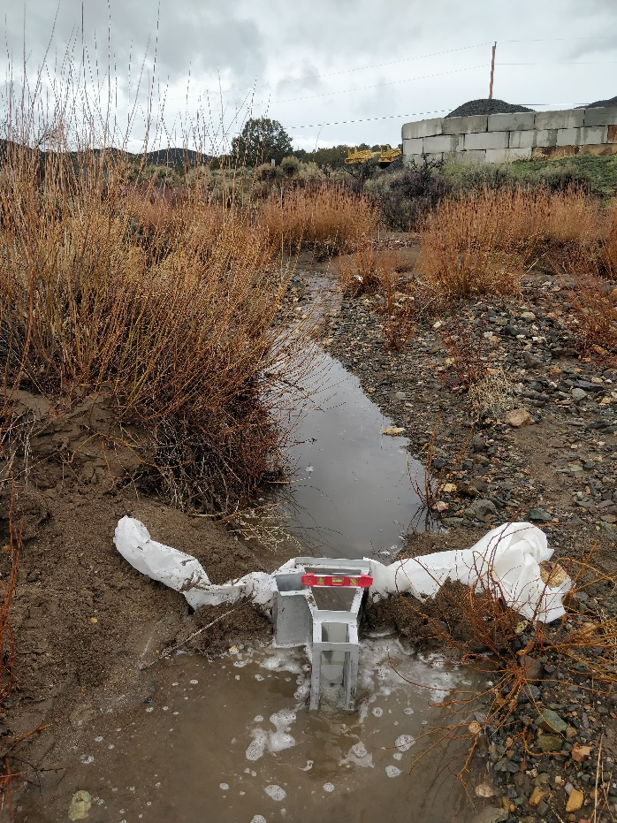
Flume Flow Loss Measurements
Difference flow at two locations over known distance of separation.
Q2 - Q1= Loss (or potential recharge)
0.5 cubic feet per second (cfs) per mile near the fire station and pinion park
Q1
Q2
Pictures from 4/7/18

Slide 38
Conclusions – What we are observing so far?
50/50 split of wells with increasing/decreasing trends.
Water-level increases and stable water levels generally occur in lower part of the highlands (near fire station).
Water-levels in wells near drainages with flow appear to have more significant increases.
Lousetown Creek is a losing stream, providing recharge to groundwater
Preliminary data suggests water-levels are continuing to decline in certain areas.
More data still needed to help understand highly varied water-level signals.

Slide 39
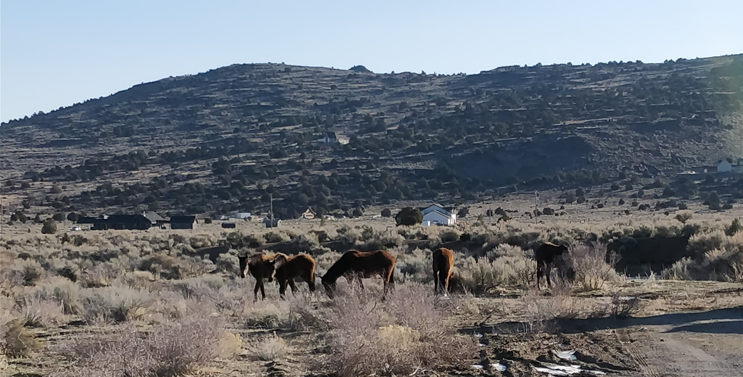
Questions?

